Slide 1
Privacy-Preserving and Fault-Tolerant
Data Storage
Haibin Zhang (UConn)
haibin.zhang@uconn.edu
http://scl.uconn.edu/people/haibin/info.php

Slide 2
Research Interests: Security and Reliability
  Cryptography of real utility
  Systems and Distributed Systems
  Intersection of the above two
  Cloud storage and cloud computing

Slide 3
This Talk: Privacy-Preserving and Fault-Tolerant Data Storage
How to securely and reliably ___ your data?
  store and access
  share and retrieve
  process

Slide 4
This Talk: Privacy-Preserving and Fault-Tolerant Data Storage
How to securely and reliably ___ your data?
  store and access
  share and retrieve
  process
Distributed storage and state machines
  either replicated or erasure-coded

Slide 5
Or: How to Securely and Reliably
___ Your Data?
Haibin Zhang (UConn)
haibin.zhang@uconn.edu
http://scl.uconn.edu/people/haibin/info.php

Slide 6
Specifically
Disk encryption for data privacy
  Length-expanding encryption
  Length-preserving ciphers
Distributed (cloud) storage
  Confidential state machine replication
  Causality-preserving state machine replication
  Cloud storage with encrypted search and share
  (Space-saving and bandwidth-efficient cloud storage)

Slide 7
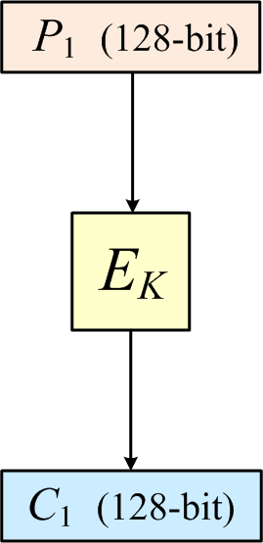
How to Use AES?
Disk Encryption
Can only encrypt messages of a fixed length (i.e., 128 bits).
But how about longer messages?
AES

Slide 8
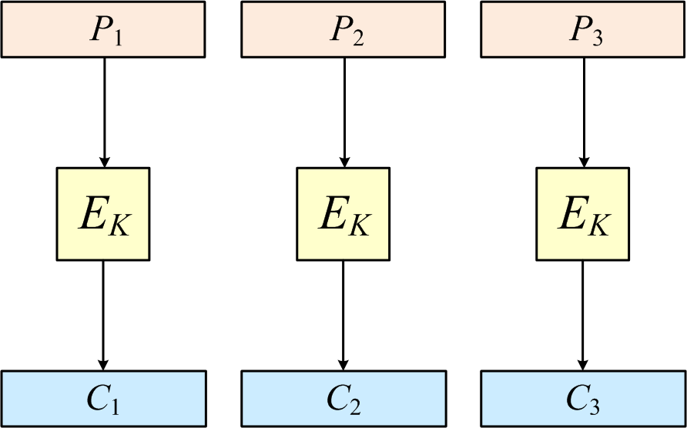
How to encrypt arbitrary-length messages?
Disk Encryption
A naïve solution: simply encrypting messages blockwise (i.e., using ECB mode)?
…
…
…

Slide 9
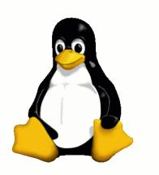
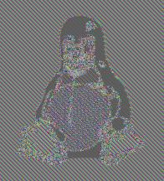
How to encrypt arbitrary-length messages?
Disk Encryption
A naïve solution: simply encrypting messages blockwise (i.e., using ECB mode)?
ECB insecure
Encrypted Penguin using ECB
Penguin

Slide 10
Secure Encryption: IND$
Disk Encryption
Ideal definition of security:
  IND$: Ciphertexts are indistinguishable from random bits.
An ideal encryption scheme must be randomized or stateful, and thus length-expanding.

Slide 11
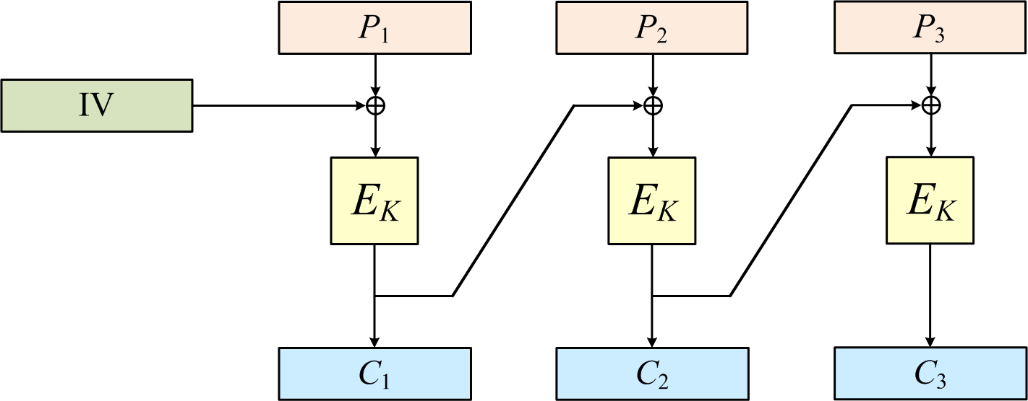
CTR and CBC achieving IND$
Disk Encryption
CTR: Maintaining an incremental counter.
CBC: Most widely used (perhaps for historical reasons).

Slide 12
Handling Incomplete Block
Disk Encryption
What if the length is not a multiple of AES blocksize?
CTR: natively handle incomplete block.
CBC: ?

Slide 13
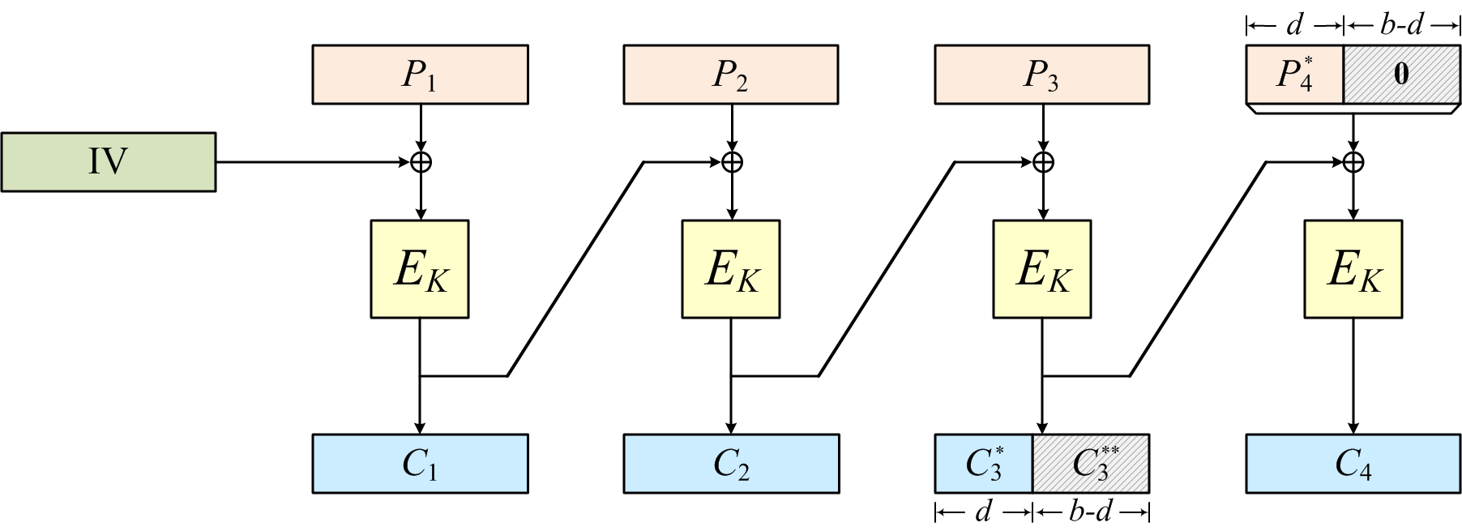
Handling Incomplete Block for CBC
Disk Encryption
CBC: with Ciphertext Stealing
  “NIST standard: Recommendation for block cipher modes of operation: three variants of ciphertext stealing for CBC mode.”
Proven by [Rogaway, Wooding, and Zhang, FSE2012]

Slide 14
Length-Preserving Encryption = Ciphers
Disk Encryption
Ideal security:
  PRP (pseudo-random permutation): Ciphers should resemble length-preserving random permutation over the message space.
Many applications ask length preservation
  E.g. encrypt your entire disk
Standards
  IEEE P1619.2---XCB and EME2

Slide 15
Difficulties Achieving Ciphers
Disk Encryption
Slow: solutions like XCB and EME2 are much slower than conventional modes (e.g., CTR and CBC).
Buffering: PRP requirement makes bounded latency impossible.

Slide 16
Online Ciphers
Disk Encryption
Weaken the PRP requirement to what is possible in the online setting.
A permutation π is online if the i-th block of ciphertext depends only on the first i blocks of plaintext.
M₁
M₂
M₃
π
C₁
C₂
C₃

Slide 17
Online Ciphers
Disk Encryption
Weaken the PRP requirement to what is possible in the online setting.
A permutation π is online if the i-th block of ciphertext depends only on the first i blocks of plaintext.
M₁
M₂
M₃
π
C₁
C₂
C₃

Slide 18
Online Ciphers
Disk Encryption
Weaken the PRP requirement to what is possible in the online setting.
A permutation π is online if the i-th block of ciphertext depends only on the first i blocks of plaintext.
M₁
M₂
M₃
π
C₁
C₂
C₃

Slide 19
Online Ciphers
Disk Encryption
Weaken the PRP requirement to what is possible in the online setting.
A permutation π is online if the i-th block of ciphertext depends only on the first i blocks of plaintext.
M₁
M₂
M₃
π
C₁
C₂
C₃

Slide 20
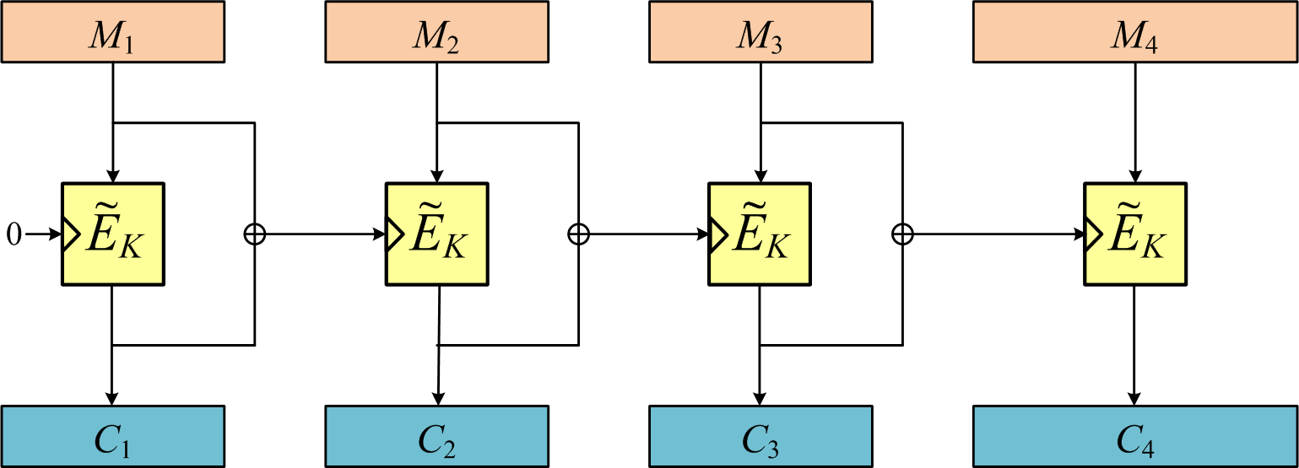
Online Cipher Construction:TC3*
Disk Encryption
Handling last block: A tweakable blockcipher for {0,1} ^{[n..2n-1]}
[Rogaway and Zhang, RSA 2011]
[Zhang, ACNS 2012]

Slide 21
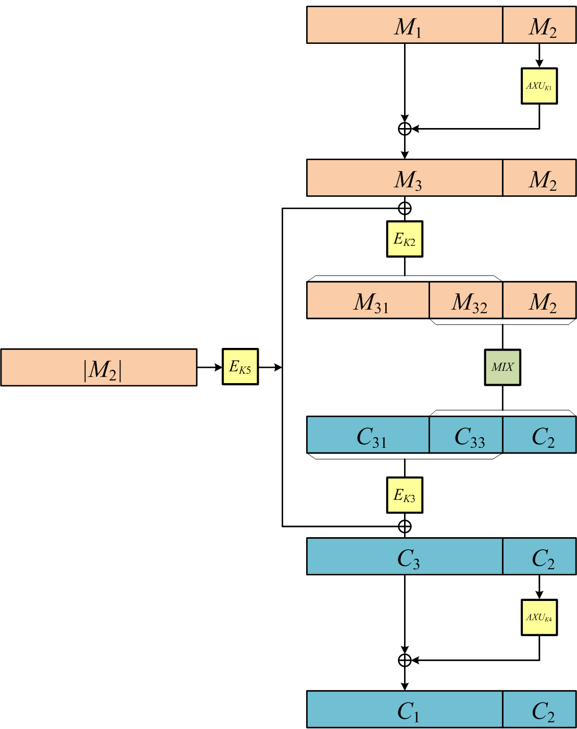
An Efficient Tweakable Cipher Mode, cont.
Disk Encryption
Only two AES calls
[Zhang, ACNS 2012]

Slide 22
Online security makes sense for encryption
Disk Encryption
CTR and a variant of CBC with ciphertext stealing are also secure in this sense.
Proven by [Rogaway, Wooding, and Zhang, FSE2012]

Slide 23
Online security makes sense for encryption
Disk Encryption
The variant of CBC is called delayed CBC, or DCBC.
Proven by [Rogaway, Wooding, and Zhang, FSE2012]

Slide 24
A Quick Summary
Summary
So far, we have talked about disk encryption for privacy
  encryption and ciphers
  security definitions and constructions
Foundations of data privacy
  if you ever need disk encryption, use them
How fast is AES?
  1,000 AES calls only takes 25 microsecond
  (1 microsecond = 0.000001 second)

Slide 25
Single Node vs. Replicated Nodes
Discussion
One may store data in a single node:

Slide 26
Single Node vs. Replicated Nodes
Discussion
One may store data in a single node:
  But this does not achieve reliability.
  What if the node fails/gets compromised?

Slide 27
Single Node vs. Replicated Nodes
Discussion
One may store data in a single node:
  But this does not achieve reliability.
  What if the node fails/gets compromised?
  In practice, almost always use replicated or erasure coded storage for major services.
We consider replicated nodes.

Slide 28
Replicated Storage
Discussion
New problems occur:
In case of
  crashes/attacks
  network partitions
  concurrency
How to
  maintain consistency?
  achieve liveness?
  if using erasure coding, different node stores different data…

Slide 29
The Rest of the Talk
Discussion
Reliability
Reliability + Privacy

Slide 30
Store/Process Data Privately in Cloud
Cloud Storage
I will introduce the following storage systems
  Confidential state machine replication
    arbitrary state machine operations (not just read/write)
    reliability and confidentiality together
  Causality-preserving state machine replication
  Bandwidth-efficient erasure-coded storage
  Scalable cloud storage w/ encrypted search&share
    industry-level search engine
    space-efficient share

Slide 31
Distributed Systems
Cloud Storage
A set of processors achieve cooperation.
“A distributed system is one which the failure of a computer you did not even know existed can render your own computer unusable.”
---Leslie Lamport

Slide 32
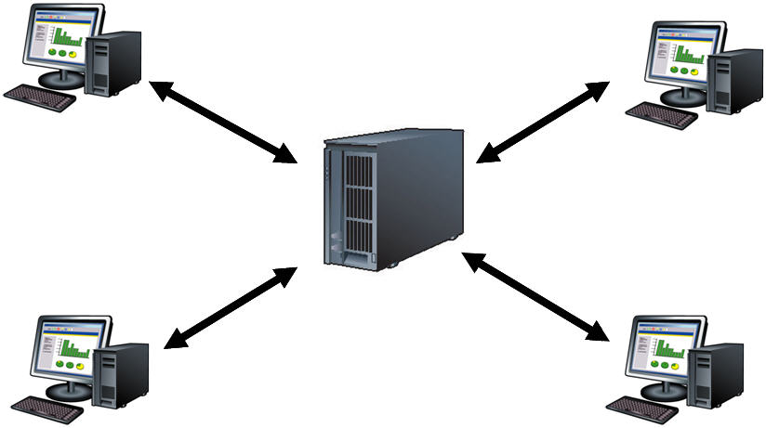
Client-Server Model
Cloud Storage
client
client
server
client
client
Scenario 1: With a single server

Slide 33
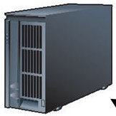
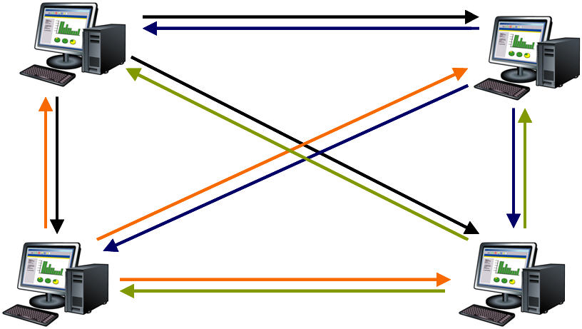
Client-Server Model
Cloud Storage
client
client
replicated servers
client
client
Scenario 2: With replicated servers

Slide 34
Model, cont.
Cloud Storage
Synchrony, partial synchrony, asynchrony
Crash failures vs. Byzantine failures

Slide 35
Model, cont.
Cloud Storage
Synchrony, partial synchrony, asynchrony
Crash failures vs. Byzantine failures

Slide 36
Byzantine Fault-Tolerant SMR+MWMR
Cloud Storage
This talk considers two important distributed systems primitives
  State machine replication (SMR)
  Multi-writer multi-reader register (MWMR)
    replicated or erasure-coded
SMR and MWMR: most relevant to cloud storage and cloud computing

Slide 37
SMR
Cloud Storage
SMR: replicas run an interactive protocol to order client requests and respond to clients with the output from their state machines.
  Paxos: SMR for crash failures
  PBFT: SMR for Byzantine failures
The “most” important backbone architecture
Every major service
  BigTable, Chubby, Spanner, Azure, Amazon Web Service, Ceph, IBM SAN, VMware NSX, …
[Lamport, ACM TOCS 1998]; earlier version 1989
[Castro and Liskov, ACM TOCS 2002]; earlier version OSDI 1999

Slide 38
More on BFT state machine replication
Cloud Storage
Our two protocols:
  Conventional:
    PBFT, Zyzzyva, Aliph, …, BChain
  Using small trusted component:
    TrInc, CheapBFT, …, ByzID
[Duan, Meling, Sean, and Zhang, OPODIS 2014]
[Duan, Levitt, Meling, Sean, and Zhang, SRDS 2014]

Slide 39
Underlying BFT state machine replication
Cloud Storage
BChain
ByzID
[Duan, Meling, Sean, and Zhang, OPODIS 2014]
[Duan, Levitt, Meling, Sean, and Zhang, SRDS 2014]

Slide 40
Confidential State Machine Replication
Cloud Storage
Achieving privacy in replicated state machines is difficult
Why?
  replication increases reliability
  replication reduces confidentiality (by, say, taking control of the weakest replica)

Slide 41
Previous SMR with Confidentiality for Cloud
Cloud Storage
In crypto, all considered a single node (e.g., FHE, ORAM)
In distributed systems, only one SMR considered confidentiality and used expensive threshold signatures
Our result: Two to Three Orders of Magnitude Faster

Slide 42
Our Approach
Cloud Storage
Separating agreement from execution (SOSP ’03)
Exploiting randomized operations
Designing a novel privacy firewall
Eliminating expensive asymmetric cryptography
[Duan and Zhang, SRDS 16]

Slide 43
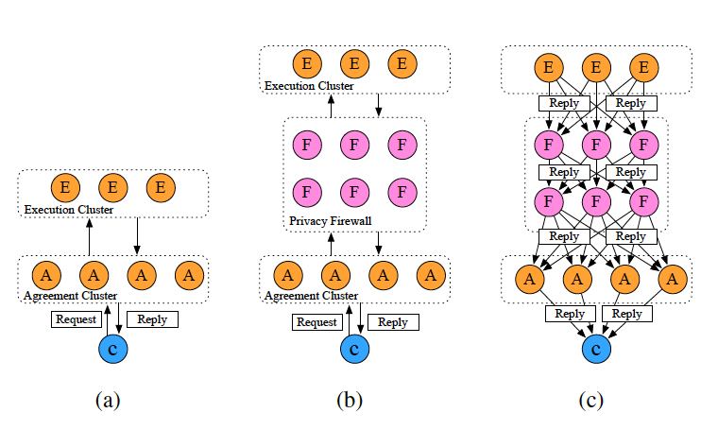
Practical Confidential SMR
Cloud Storage

Slide 44
Another Privacy Goal: Causality-Preserving
Cloud Storage
Only make sense in distributed systems
Causality-preserving SMR
  Stock trading service, name service, …
[Reiter and Birman, TOPLAS 94]

Slide 45
Causality-Preserving SMR Scenarios
Cloud Storage
A trading service that trades stocks.
A client issues a request to purchase stock shares.
A corrupt replica could collude with a corrupt client to issue a request for the same stock.
If the new request is processed earlier than the original request,
  this may adjust the demand for the stock

Slide 46
Causality-Preserving SMR
Cloud Storage
Existing Constructions
  Using labeled CCA-threshold encryption
  Commit the ciphertext before revealing shares
Drawbacks?
  SMR does not really need PKC
  Threshold encryption impacts performance significantly

Slide 47
Causality-Preserving SMR
Cloud Storage
An ongoing work
  Three novel constructions that avoid using any public key crypto
[Reiter and Zhang]

Slide 48
Erasure-Coded Storage
Cloud Storage
A storage with strong consistency and low bandwidth
Enjoy “all” the attractive features --- privacy, access control, deduplication, and proof of ownership --- all in a decentralized manner
Designed specifically for OpenStack Swift
[Reiter and Zhang]

Slide 49
Replication vs. Erasure coding (EC)
Cloud Storage
3-Replication (tolerating 2 failures)
(6-data, 3-redundant) Erasure code (tolerating 3 failures)
Data fragments
Coded fragments
(more than) 50% savings!

Slide 50
EC widely used
Cloud Storage
Google uses (6, 3) Reed-Solomon EC in GFS II
Facebook uses (10, 4) RS EC in HDFS-RAID
Microsoft uses a (12, 4=2+2) EC (tolerating 3 failures) in Azure
Ceph, OpenStack, …
Almost all cloud storage systems now support EC

Slide 51
EC widely used, but
Cloud Storage
As additional/back-end storage tier
  Replication as front-end
As cold storage tier
  Not allow update (append only)
Not achieve strong consistency
Not resilient to Byzantine (arbitrary) failures

Slide 52
Bandwidth-Efficient Erasure-Coded Storage
Cloud Storage
The strongest model:
  readers, writers, and a fraction of servers are Byzantine
  asynchronous environments

Slide 53
Bandwidth-Efficient Erasure-Coded Storage
Cloud Storage
Strong consistency:
  linearizable read and write
Linearizability:
  even in case of concurrency and failures

Slide 54
Bandwidth-Efficient Erasure-Coded Storage
Cloud Storage
Largely reduces (compared to other EC storage):
  read and reconstruct bandwidth and system I/O
  using novel erasure coding and a new design

Slide 55
Bandwidth-Efficient Erasure-Coded Storage
Cloud Storage
Other features:
  strong privacy
  flexible access control (specified by data owner)

Slide 56
Bandwidth-Efficient Erasure-Coded Storage
Cloud Storage
Decentralized secure deduplication of encrypted data
  first of its kind that does not rely on an independent server
Proof of ownership
  to securely enable secure client-side dedup
  take advantage of erasure coding schemes

Slide 57
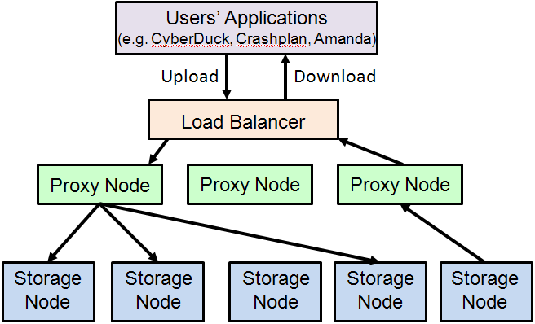
OpenStack Swift Implementation
Cloud Storage
Readers & writers

Slide 58
Fully Functional and Scalable Cloud Storage
Cloud Storage
Norton Zone: Symantec’s cloud storage
Fully functional: security, reliability, availability, encrypted search, secure file share
Scalable: at its peak, 300, 000 accounts

Slide 59
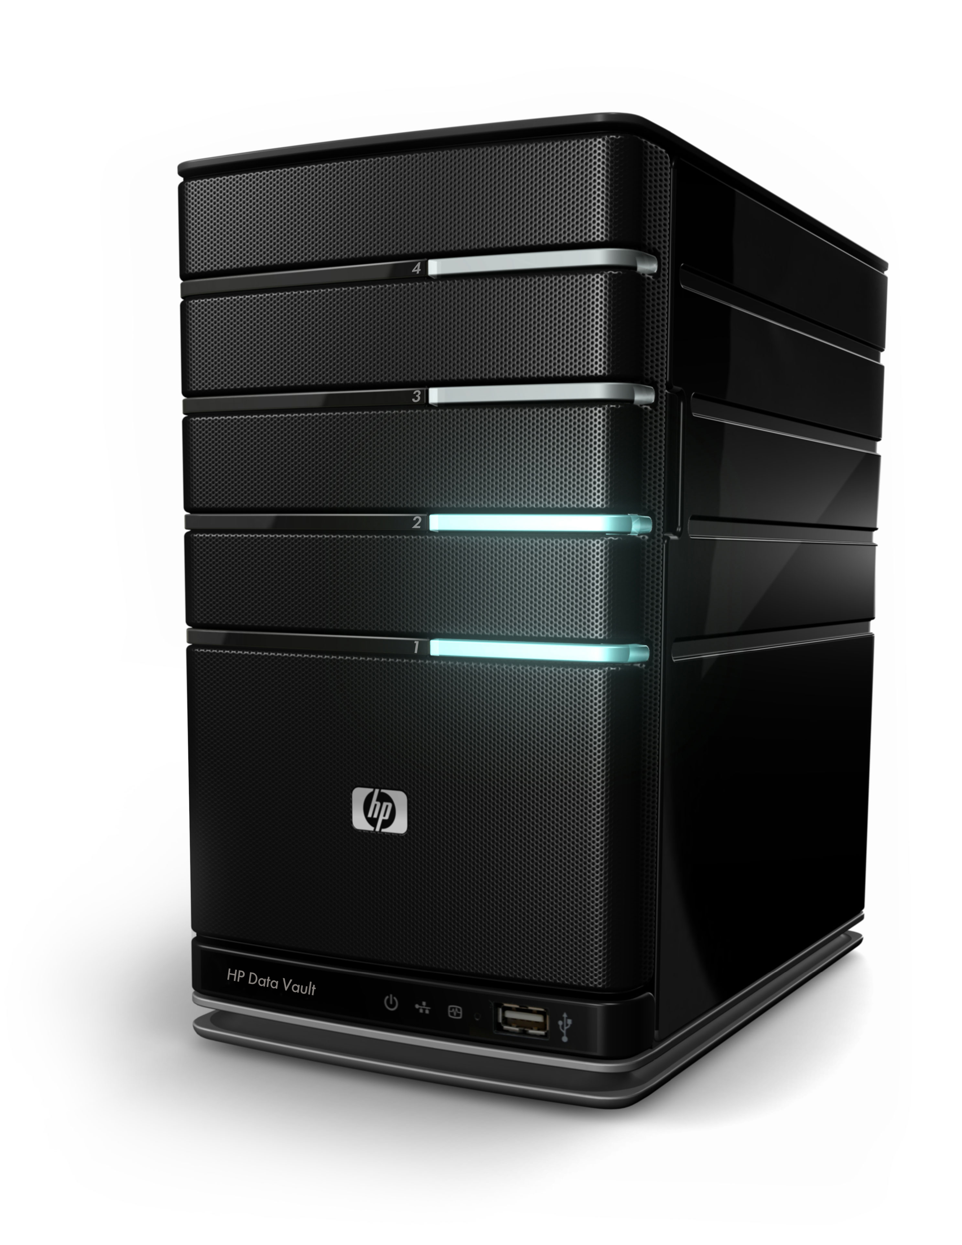
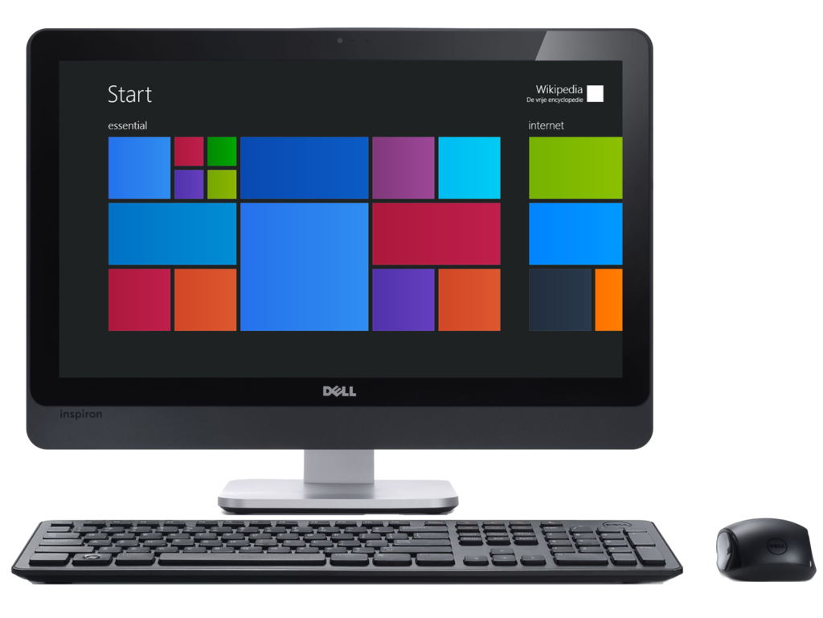
What’s Encrypted Search?
Cloud Storage
Outsourcing data to untrusted service provider
Encrypted Data
Keep the key

Slide 60
What’s Encrypted Search?
Cloud Storage
Outsourcing data to untrusted service provider
Query

Slide 61
What’s Encrypted Search?
Cloud Storage
Outsourcing data to untrusted service provider
Query
Encrypted Result

Slide 62
Fully Functional and Scalable Cloud Storage
Cloud Storage
Three US patents:
  Systems and methods for securing data at third-party storage services.
  Systems and methods for maintaining encrypted search indexes on third-party storage systems.
  Systems and methods for searching shared encrypted files on third-party storage systems.
A technical paper:
  Norton Zone: Symantec's Secure Cloud Storage System.
[Zhang, Schneider, Bogorad, Sundaram, granted]
[Zhang, Schneider, Bogorad, Sundaram, pending]
[Schneider, Bogorad, Zhang, Sundaram, granted]
[Bogorad, Schneider, and Zhang, SRDS 2016]

Slide 63
Fully Functional and Scalable Cloud Storage
Cloud Storage
Valet security model
  in between on-promise and off-promise security

Slide 64
Fully Functional and Scalable Cloud Storage
Cloud Storage
Off-promise security
  data in the service provider’s control
  Dropbox, Box, OneDrive, Google Drive, …
On-promise security
  data in customer’s control
  no encrypted search
  Mega, SpiderOak, Wuala, …
Valet security
  In between off-promise and on-promise security
  trusts the server in a limited scope

Slide 65
Fully Functional and Scalable Cloud Storage
Cloud Storage
Encrypted Lucene
  Lucene transform
Space-efficient share
Other features: four-fold replication, against various attacks, …

Slide 66
Summary: Three Most Important Goals
Integrity (= Safety)
Availability (= Liveness)
Confidentiality/Privacy

Slide 67
Things Not Covered, but Equally Interesting
Obliviousness
  oblivious storage/RAM
Alternative way of achieving integrity
  proof of retrievability, provable data procession
Deniability
  file system
…
More broadly, if we think “storage with computation” …

Slide 68
Thank you!
Questions?

Slide 69
Thank you!
Questions?
Security Seminar Webpage:
http://scl.uconn.edu/seminar/index.php

