Slide 1
Cellular Automata
Reversibility

Slide 2
Sources
Material in this lecture comes from, “Handbook of Natural Computing,” Editors Grzegorz Rosenberg, Thomas Back and Joost N. Kok, Springer 2014.

Slide 3
What is reversible computing??
The computation can be reversed: out → in
No information is lost
Information (Shannon) entropy (uncertainty) is not increased
Can one do as much with reversible computation as with general computation??
Yes, there are reversible TM universal CA
Why is reversible computation of interest??
No thermodynamic entropy increase → no information (bits) are erased which would otherwise dissipate into heat energy
Are there any drawbacks to reversible computing??
Need garbage collection (leads to extra circuitry/area overhead)
Need to run the inverse in order to check for faults

Slide 4
Thermodynamics:
System: aggregation of bodies considered as a whole and assumed to be isolated from their surroundings
Single-phase system: system contains one gas, liquid, solid, or plasma
Has an equation of state:
$F\left(p,t,V\right)=0$
$p$denotes pressure
$t$denotes temperature in celcius
$V$denotes volume
According to which the condition of the system is determined by fixing the values of two of the variables

Slide 5
Law of Boyle and Mariotte:
$$p V\left(p,t\right)=p_{0} V(p_{0},t)$$
At constant temperature the volume of a gas is inversely proportional to pressure
Law of Gay-Lussac:
$$V\left(p,t\right)=V\left(p,0\right)\left(1+\frac{t}{273}\right)$$
At constant pressure the rate of change of volume per degree is independent of temperature
Define:
$$T=273+t$$
$$p V=\frac{p_{0} V\left(p_{0}, 273\right)}{273}T$$

Slide 6
Law of Avogadro:
$$\frac{M_{1}}{V_{1}} :\frac{M_{2}}{V_{2}}=m_{1} :m_{2}$$
The densities of any two gases which are at the same temperature and pressure are proportional to relate to the molecular weights
$$\frac{mV}{M}=v$$
A constant, which is the same for any gas, representing the volume occupied by one mol
$$p v=\frac{p_{0}v_{0}}{273} T=k T$$
k = Boltzmann’s constant
$$p V=\frac{M}{m} k T=n k T$$
n = the number of mols gas present

Slide 7
The final equation holds for large temperatures …
The equation is for an “ideal gas”
For T=0 we have pV=0, which is not possible (gas molecules do not have zero volume and gas molecules make one another move through attractive forces which gives non-zero pressure):
In the law of Boyle and Mariotte
Subtract the volume of the gas molecules, denoted by $b$
Add to the pressure the internal pressure as a result of intermolecular forces of attraction:
Internal pressure ~ (# colliding molecules with the walls) x (Force) ~ (density of the gas)^2 ~ $\frac{1}{v^{2}}$
Internal pressure is $\frac{a}{v^{2}}$
Van der Waals gas (a real gas):
$$\left(p+\frac{a}{v^{2}}\right)\left(v−b\right)=k^{′}T$$
k’ is now gas dependent

Slide 8
For small constant T:
Part of the gas begins to liquidify
For larger T there are no extrema and it is not possible to liquidify the gas by compression
p
v

Slide 9
1st Law of thermodynamics:
Principle of conservation of energy (Robert Mayer)
In a closed system the total store of energy, i.e. the sum of the heat energy and mechanical or electrical energy is constant
It is impossible to construct a machine which does work without obtaining energy from an external source
Cannot construct a perpetual motion machine of the 1st kind
Total energy U as a function of (any two out of) T, V, p. We use U=U(T,V):
$$dU=\frac{∂U}{∂T} dT+\frac{∂U}{∂V} dV$$

Slide 10
It may not be that the part of the energy of the system which exists in the form of heat be supplied as heat (it may be supplied, e.g., as the mechanical energy in compression)
$$δQ+ δW=dU$$
If every element dS of the surface experiences a displacement δs, then (work = force x distance)
$$δW=−\oint{p dS δs}=−p \oint{dS δs}=−p dV$$
$$δQ=dU+p dV$$
dU is the increase in internal energy
p dV is the amount of external work performed
$$δq=du+p dv$$

Slide 11
$$δq=du+p dv$$
$$\frac{δq}{dT}=\frac{∂u}{∂T}=c_{v}$$
For constant volume:
$$dv=\frac{∂v}{∂T} dT+\frac{∂v}{∂p} dp=\frac{∂v}{∂T} dT$$
For constant pressure:
$du=\frac{∂u}{∂T} dT+\frac{∂u}{∂v} dv=c_{v}$ $dT+\frac{∂u}{∂v} dv$
$\frac{δq}{dT}=c_{v}+(\frac{∂u}{∂v}+p$) $\frac{∂v}{∂T}=c_{p}$
For an ideal gas:
No forces acting between molecules ➔Energy is independent of distances between molecules ➔ independent of volume ➔ $\frac{∂u}{∂v}=0$ and $u=u(T)$, $du=c_{v}dT$
$vdp+pdv=kdT$, i.e. $dT=\frac{pdv+vdp}{k}.$ Hence, $dp=0$ ➔ $\frac{∂v}{∂T}=\frac{k}{p}$
$$c_{p}−c_{v}=k$$
Adiabatic process (no heat is communicated to or abstracted from the system):
$0=du+pdv⇒{0=c}_{v}\frac{pdv+vdp}{c_{p}−c_{v}}+pdv⇒\frac{c_{p}}{c_{v}}\frac{dv}{v}+\frac{dp}{p}=0⇒pv^{γ}=const, γ=\frac{c_{p}}{c_{v}}$
$$⇒Tv^{j−1}=const$$

Slide 12
Carnot cycle & the ideal heat engine
Reduce external pressure: allowing the gas to expand isothermally
Gas does work against the external pressure & the equivalent amount of energy is taken from the boyler
External work done:
$$W_{12}=\int_{v_{1}}^{v_{2}}{pdv}=kT_{B}\int_{v_{1}}^{v_{2}}{\frac{dv}{v}}=kT_{B}\ln\left(\frac{v_{2}}{v_{1}}\right)$$
2.
1.
Isothermal boiler @ $T_{B}$

Slide 13
Carnot cycle & the ideal heat engine
Gas is allowed to expand adiabatically until the temperature drops to $T_{C}$ (that of the condenser)
External work done:
$W_{23}=\int_{v_{2}}^{v_{3}}{pdv}=p_{2}v_{2}^{γ}\int_{v_{2}}^{v_{3}}{\frac{dv}{v^{γ}}}=\frac{p_{2}v_{2}^{γ}}{1−γ} \left(v_{3}^{1−γ}−v_{2}^{1−γ}\right)=\frac{kT_{B}}{1−γ}\left( {\left(\frac{v_{3}}{v_{2}}\right)}^{1−γ}−1\right)=\frac{k}{γ−1}(T_{B}−T_{C})$
Notice $v_{3}=v_{2}{\left(\frac{T_{C}}{T_{B}}\right)}^{1/(1−γ)}$
3.
2.
Cylinder removed from boiler and insulated

Slide 14
Carnot cycle & the ideal heat engine
Increase external pressure: The gas is isothermally compressed to a volume $v_{4}$ such that if it be adiabatically compressed to $v_{1}$, then it attains the initial temperature $T_{B}$
External work done:
3.
4.
$$W_{34}=\int_{v_{3}}^{v_{4}}{pdv}=kT_{C}\int_{v_{3}}^{v_{4}}{\frac{dv}{v}}=kT_{C}\ln\left(\frac{v_{4}}{v_{3}}\right)$$
where
$$v_{4}=v_{1}{\left(\frac{T_{C}}{T_{B}}\right)}^{1/(1−γ)}$$
hence, $\frac{v_{4}}{v_{3}}=\frac{v_{1}}{v_{2}}$
Isothermal condenser @ $T_{C}$

Slide 15
Carnot cycle & the ideal heat engine
The gas is adiabatically compressed to $v_{1}$(and attains the initial temperature $T_{B}$)
External work done:
$W_{41}=\int_{v_{4}}^{v_{1}}{pdv}=\frac{k}{γ−1}(T_{C}−T_{B})$
4.
1.
Cylinder removed from condenser and insulated
Total external work done:
$$W=W_{12}+W_{23}+W_{34}+W_{41}=kT_{B}\ln\left(\frac{v_{2}}{v_{1}}\right)+kT_{C}\ln\left(\frac{v_{4}}{v_{3}}\right)=k\left(T_{B}−T_{C}\right)\ln\left(\frac{v_{2}}{v_{1}}\right)$$

Slide 16
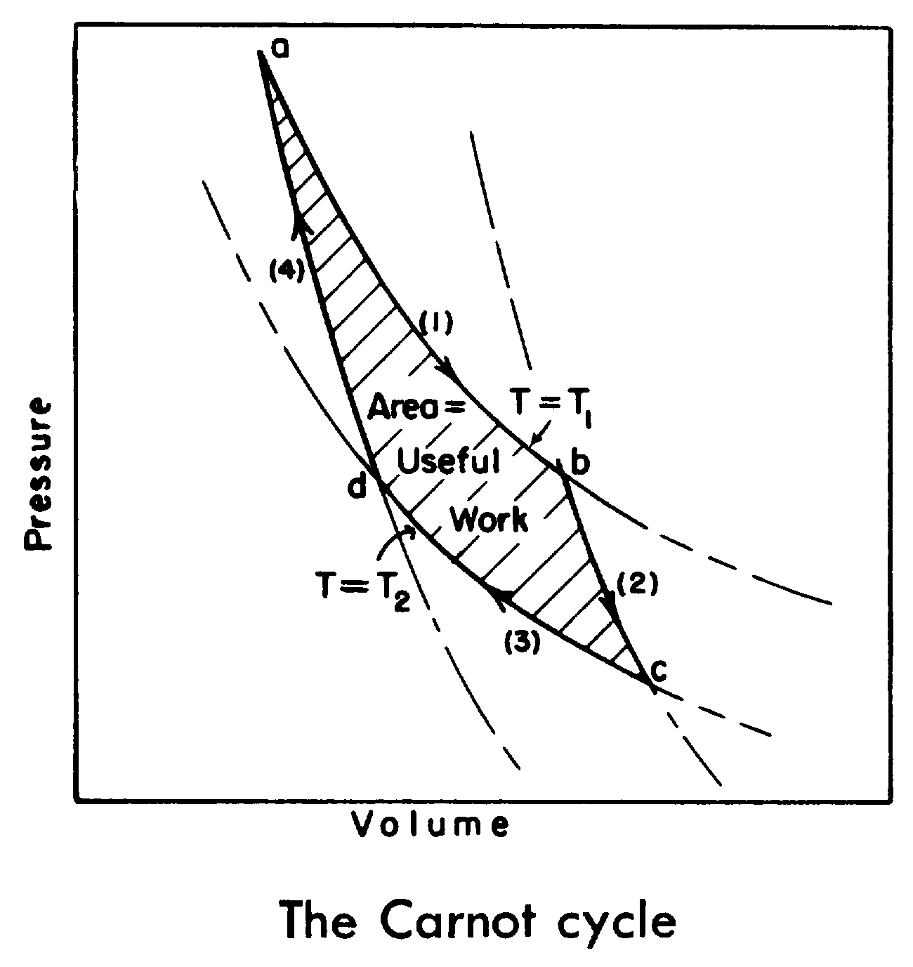
PV diagram:
T_1 = T_B
T_2 = T_C
Isothermal lines
Adiabatic lines

Slide 17
Quantity of heat $Q_{1}=kT_{B}\ln\left(\frac{v_{2}}{v_{1}}\right)$ (= the work done in the first step) was removed from the boiler and delivered to the engine
A fraction $η=\frac{W}{Q_{1}}={(T}_{B}−T_{C})/T_{B}$ was converted into useful mechanical work
while $Q_{3}=kT_{C}\ln\left(\frac{v_{2}}{v_{1}}\right)=\frac{Q_{1}T_{C}}{T_{B}}=Q_{1}(1−η)$ was returned to the condenser
Notice $\frac{Q_{1}}{T_{B}}=\frac{Q_{3}}{T_{C}}$
$η$ is called the efficiency of the heat engine
All steps are reversible ➔ Engine can be used to extract $Q_{3}$from the condenser delivering it to the boiler (requires work $W=ηQ_{1}=\frac{ηQ_{3}}{1−η}$)

Slide 18
Does there exist a super-Carnot engine? With higher efficiency?
Use the super engine to take $Q$ from the boiler:
$\left(1−η_{s}\right)Q$ is returned to the condenser
$η_{s}Q$ does useful work
The Carnot engine can recover $\left(1−η_{s}\right)Q$ by doing $W=\frac{η}{1−η}\left(1−η_{s}\right)Q$ external work
Total useful work: $η_{s}Q$ minus $\frac{η}{1−η}\left(1−η_{s}\right)Q$, which is equal to $\frac{η_{s}−η}{1−η}Q>0$
The thermal equivalent has been abstracted from the boiler, without delivery of any of it to the condenser, which is therefore not required
The mechanism does mechanical work & cools the boiler without causing any alteration in the condition of any other body!
We have a perpetual motion machine of the 2nd kind

Slide 19
2nd Law of thermodynamics:
It is impossible to construct a continuously operating machine which does mechanical work and which cools a source of heat without producing any other effects (Thomson & Planck)
The Carnot engine satisfies $\oint{\frac{dQ}{T}}=0$
Consider the adiabatic and isothermal lines in a p-v diagram: each cell represents a cycle of a Carnot engine ➔
More generally, $\oint{\frac{dQ}{T}}<0$ means that heat is being supplied to the boiler at the expense of mechanical energy. If =0, then we have a reversible process. If >0, then heat is taken from the boiler and converted into mechanical energy and we have a perpetual motion machine of the 2nd kind.

Slide 20
Define entropy $S= \int_{initial}^{2}{\frac{dQ_{rev}}{T}}$ which is a function only at the final state 2 (➔entropy is well defined)
$$S_{2}−S_{1}=\int_{1}^{2}{\frac{dQ_{rev}}{T}}$$
An irreversible passage from state 1 to 2 can be extended with a reversible passage from 2 to 1:
$$0≥\oint{\frac{dQ}{T}}=\int_{1}^{2}{\frac{dQ_{irr}}{T}+\int_{2}^{1}{\frac{dQ_{rev}}{T}}}=\int_{1}^{2}{\frac{dQ_{irr}}{T}}+S_{1}−S_{2}$$
For isolated systems there is no exchange of heat with the environment and $\int_{1}^{2}{\frac{dQ_{irr}}{T}}=0$, this proves that in any change $S_{2}−S_{1}≥0:$
All changes within an isolated system proceed in such a way that the entropy increases; hence changes will occur in such a system until the entropy has reached its maximum value

Slide 21
Take point 1 as an initial reference point:
$$0≥\int_{1}^{2}{\frac{dQ_{irr}}{T}}+S_{1}−S_{2}$$
Differentiating gives
$$0≥\frac{dQ}{T}−dS=\frac{dU−δW}{T}−dS$$
Equality holds for a reversible process in which case $−δW=pdV$. Entropy can be defined in the form of a differential equation:
$$dS=\frac{dU+pdV}{T}$$
For constant temperature and a reversible process:
$$d\left(U−TS\right)=δW$$
Which is called the free energy, the maximum obtainable external work

Slide 22
Bennett:
Consider a gas with a single molecule. Suppose it is known whether the molecule is on the left (0) or right (1). Then, without external work a piston can be pushed either from the right or left, respectively:
Now, immerse into a heat bath @ $T$which warms the cell: The molecule pushes the piston out. This provides free energy $kT\ln{2}$ Joules/bit and increments the entropy by $δS=k\ln{2}$
Erasing bits in CMOS gates will produce energy in the form of heat
Explains the energy value of information → Relation between thermodynamic entropy and information entropy! Both are engineering contributions to physics.

Slide 23
CA is reversible iff it is injective
For a 1D reversible CA, if N consists of consecutive cells, then $\left|N^{′}\right|≤{\left|S\right|}^{\left|N\right|−1}−(|N|−1)$for its inverse
Whether a 1D CA is injective is decidable
Whether a 2D CA is injective is undecidable
There is no computable function g that satisfies $\left|N^{′}\right|≤g(\left|S\right|,\left|N\right|)$ for any 2D reversible CA

Slide 24
CAs with block rules
Unconventional:
Each cell knows the parity of time and the relative position in a block

Slide 25
Partitioned CAs
Notice that f is from Q to Q and can be designed to be injective:
Local function f is injective iff global function F is injective
PCAs form a subset of the CAs

Slide 27
2nd order CAs:
Cells remember their previous state, which is “added” to the outcome of the local rule
Reversible for any local rule ☺

Slide 28
Corollary: There exists a TM-universal 2D RCA
Corollary: There exists a TM-universal 1D RCA

Slide 31
Next lecture: Read Chapter 9
= Read sections 1, 3.1.2, 3.3, 3.4, 4, 5.1, intro 5.2
= Glance over all other (sub-)sections

