Slide 1
Evolutionary Computation
Multi-objective Evolutionary Optimization

Slide 2
Sources
“Handbook of Natural Computing,” Editors Grzegorz Rosenberg, Thomas Back and Joost N. Kok, Springer 2014.
“Multi-Objective Evolutionary Algorithms”, Kalyanmoy Deb, Indian Institute of Technology Kanpur.

Slide 7
Is a pre-order (instead of a partial order) since antisymmetry is not guaranteed.

Slide 15


Slide 16
The other methods implicitly generate such an ordering.

Slide 22
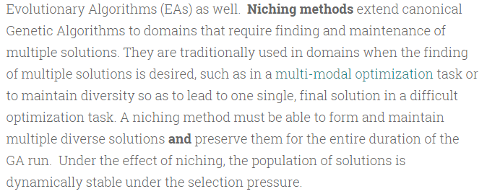

Slide 32
selected

Slide 36
Also called rank r_i

Slide 37
P_t also has an archival role

Slide 38
Distance of i is proportional to half the perimeter of the cuboid
Distances can be used to do “crowd-sorting”

