Slide 1
Assignment on PUF modelings based on LR and CMA-ES
Avenger Team ☺
Email: your.name@engr.uconn.edu

Slide 2
Lab’s Goals
Simulate APUF and XOR PUF
Simulate noisy APUF and noisy XOR PUF
Implement LR-based modeling attacks on reliable APUF
Implement CMA-ES based modeling attacks on noisy APUF
Implement CMA-ES based modeling attacks on noisy XOR PUF

Slide 3
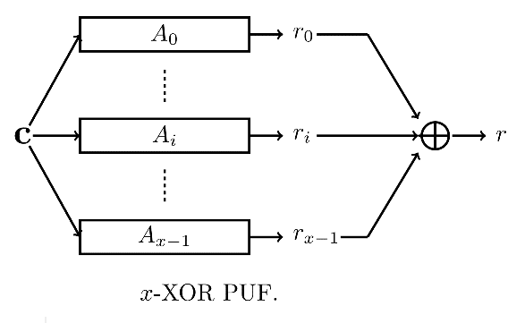
Simulate reliable APUF and XOR APUF
To simulate 64-bit APUF and 64-bit 3-XOR PUF, you are required to use the linear delay model of APUF described as right hand side and w[i]s are randomly sampled from a given normal distribution N(0,\sigma), \sigma = 1.
You are required to create two sets for modeling attack on APUF based on Logistic Regression and CMA-ES, i.e., training set Q={ci,ri} and test set T = {ci,ri}. |Q| = 2000 and |T|= 1000.

Slide 4
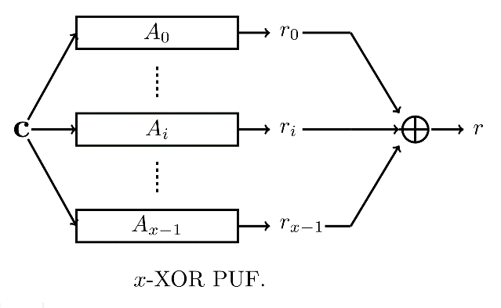
Simulate noisy APUF and noisy XOR APUF
You first generate 64-bit reliable APUF and 64-bit 3-XOR PUF by using the trick: w[i]s follow N(0,\sigma) where \sigma = 1.
To measure the reliability information R of a given challenge c for the generated PUF instance, we evaluate PUF M times. For the time k, the Phi is computed by using c, and the noise w’[i]s of w[i] follow N(0,\sigma_noise) where \sigma_noise = u*\sigma where 0< u <1. After that the response r_k is computed based on \Phi, w_k[i]=(w[i]+w’[i]). The reliability R is defined as
R = |M/2 - \sum_{k=1}^M r_k|
You are required to prepare the two sets for modeling attack on noisy APUF and noisy 3-XOR PUF by using CMA-ES: training set Q={ci,Ri} and test set T = {ci,ri}. In set T can contain the set of challenge and response pairs of reliable PUF instance. |Q|=20.000, |T|=1000, M=5 and u=0.2

Slide 5
Strategy of Modeling Attacks
To attack a PUF instance you need to do the following steps:
Step 1: Define the mathematical model of PUF instance
Step 2: Collect training set Q and testing set T
Step 3: Define the machine learning algorithm you want to use

Slide 6
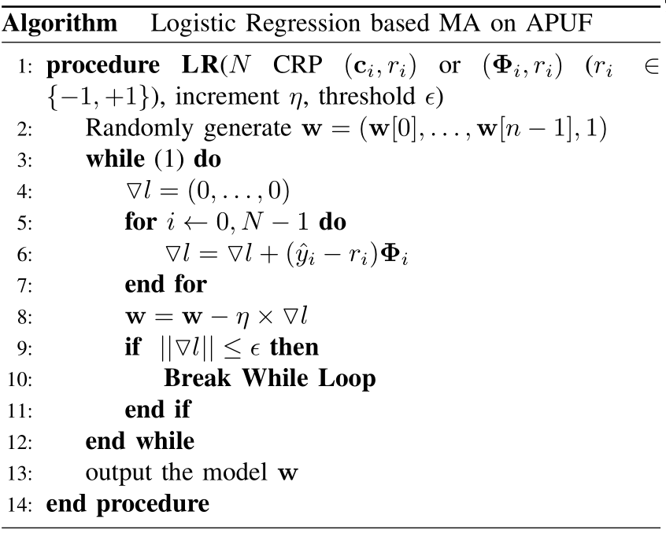
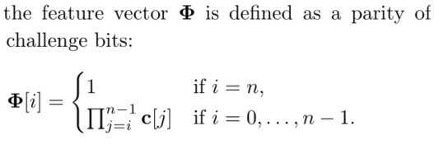
Logistic Regression: Pseudo Code of LR

Slide 7
Logistic Regression based modeling attack on reliable APUF
You are asked to simulate a 64-bit reliable APUF and then collect the training set Q and testing set T.
Apply the LR algorithm on training set Q to build the model w of the PUF instance
You are asked to report the modeling accuracy of model w by using the testing set T
|Q|=2000, T=1000, \sigma = 1

Slide 8
CMAES Algorithm
The code of CMAES can be found in
https://en.wikipedia.org/wiki/CMA-ES
or
https://www.lri.fr/~hansen/cmaes_inmatlab.html
You are required to follow the code in the link to implement the CMAES by yourself or you can use the implemented code of CMAES in the link above for Matlab and Python.

Slide 9
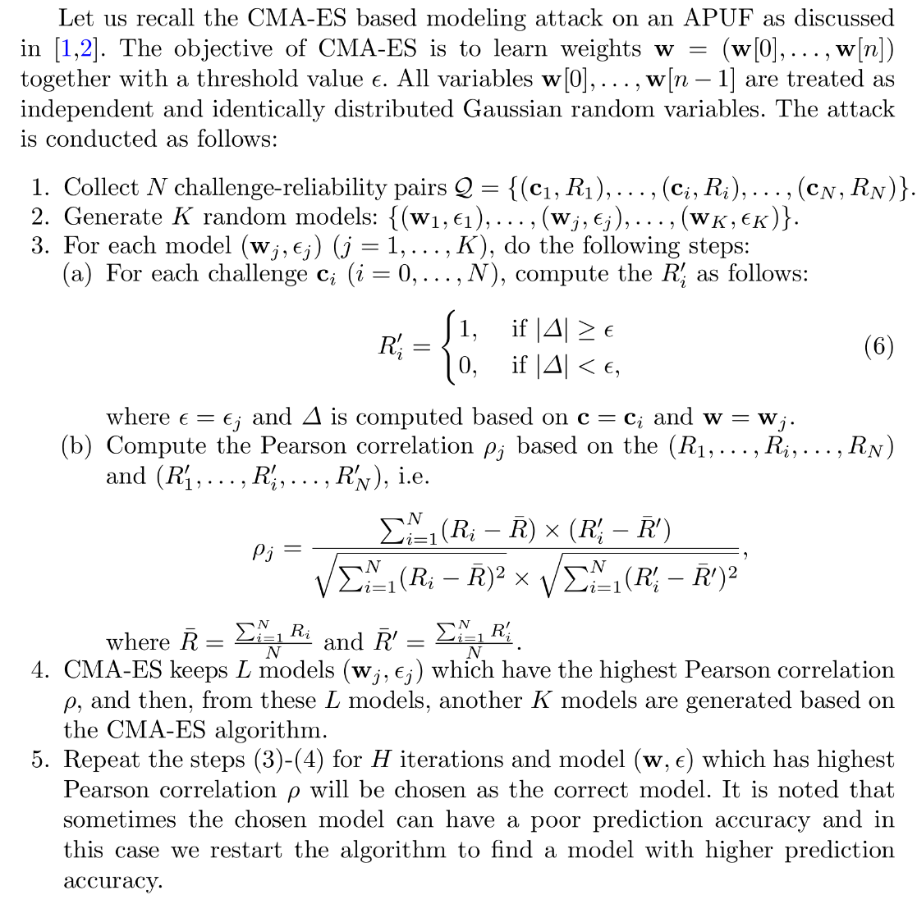
CMA-ES based modeling attack on noisy APUF
You are required to implement 64-bit noisy APUF to collect the training set Q={ci,Ri} and training set T={ci,ri}
You are asked to implement the CMA-ES base
modeling attack on noisy APUF by using Q
You are asked to report the modeling accuracy of
your attack by using set T
|Q|=20000, |T|=1000, \sigma = 1,
\sigma_noise=1/2*\sigma, M = 10.

Slide 10
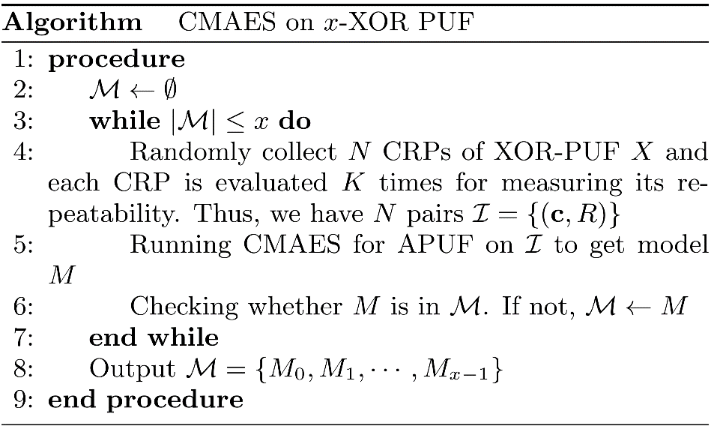
CMA-ES based modeling attack on XOR PUF
You are required to implement 64-bit noisy 3-XOR PUF to collect many training sets Q={ci,Ri} and one testing set T={ci,ri}
You are asked to implement the CMA-ES base modeling attack on noisy APUF by using Q
You are asked to report the modeling accuracy of your attack by using set T, i.e., report the model of all APUF instances in 3-XOR PUF and its modeling accuracy
|Q|=20000, |T|=1000, \sigma = 1, \sigma_noise=1/2*\sigma, M = 10.

